Slide 1

Falco para Kubernetes

Slide 2
Seguridad runtime en clusters Kubernetes con Falco

Slide 3
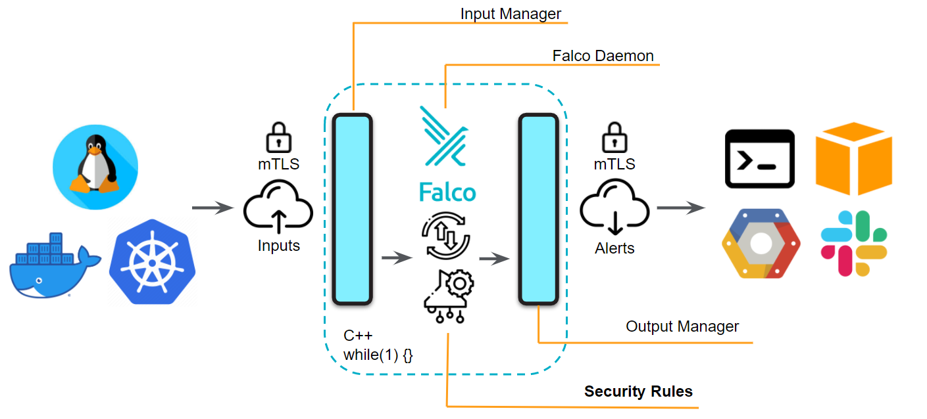
Arquitectura

Slide 4
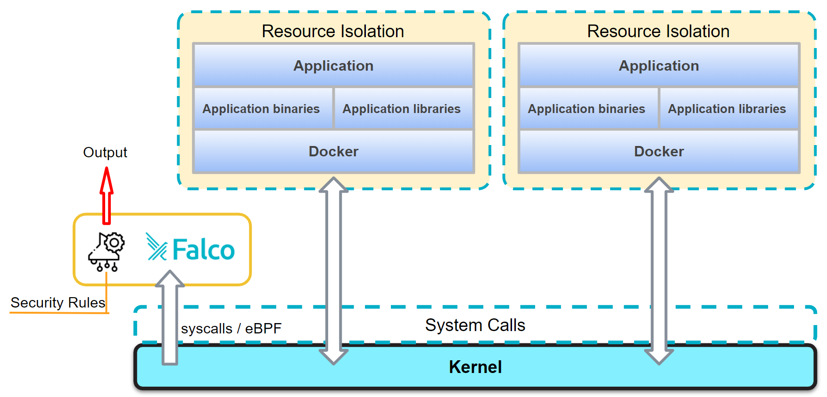

Slide 5
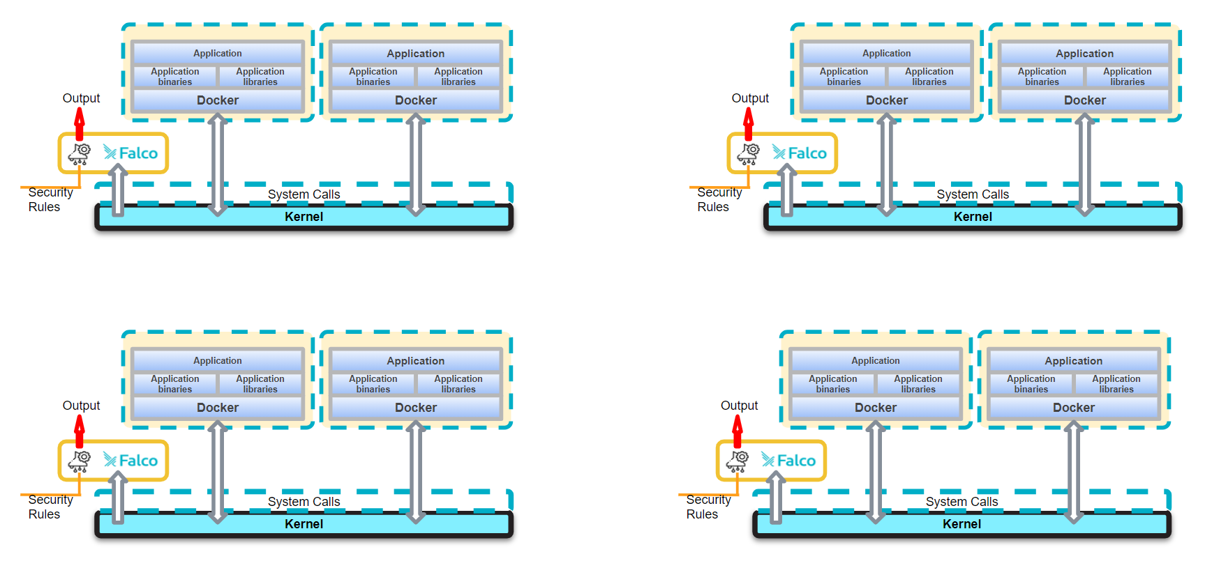

Slide 6
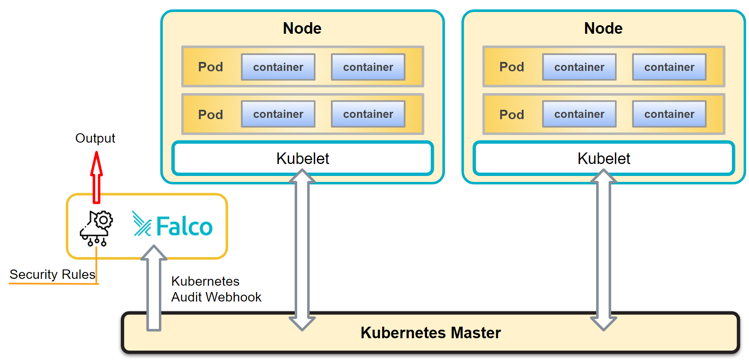

Slide 7
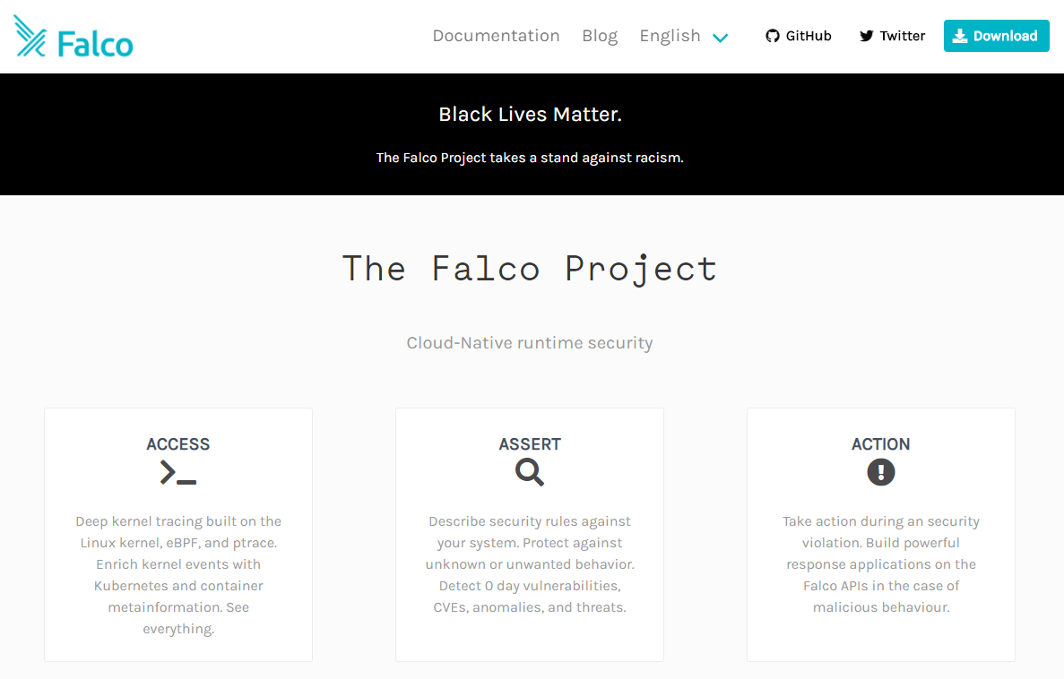
falco.org
Sitio principal:
falco.org
Documentación:
falco.org/docs/
Repositorio git:
github.com/falcosecurity/falco
Blog:
falco.org/blog/

Slide 8



VM vs Machine
Machine
Machine
VM
VM
Application
Application
Application
Application
Application
Application
Operating System
Operating System
Kernel
Kernel
Operating System
Kernel
Virtualization Software
Operating System
Kernel
virtualbox, kvm2, hyperkit, hyper-v, parallels, vmware

Slide 9
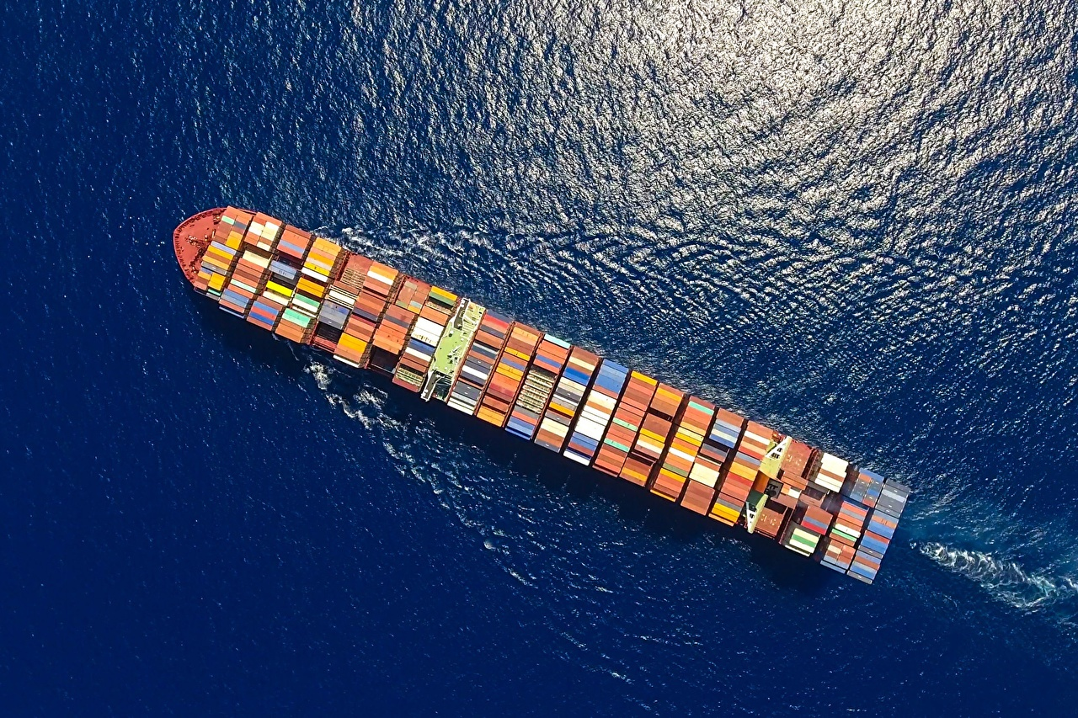

Containers
Machine
Dockerfile
Layers
Image building
Registries
Health check
Volumes Networking
OCI specification
Docker Containerd
CRI-O
rkt
podman
Container
Container
Application
Application
Container
Container
Application
Application
Kernel
Container runtime
Operating System
Kernel

Slide 10
K8s
Worker Node
Pod
Pod
Container
Container
Application
Application
Container
Container
Master Node
Application
Application
controller manager
scheduler
API server
Kernel
etcd
Kubelet, container runtime, networking
Kubelet, container runtime, networking
Operating System
Operating System
Kernel
Kernel

Slide 11
Cluster típico
Nodos “Worker”
CONTROL PLANE
Número impar de nodos “master”

Slide 12

Cluster de un solo nodo
Worker Node
Pod
Pod
Container
Container
Application
Application
Container
Container
Application
Application
Kernel
controller manager
scheduler
API server
etcd
Kubelet, container runtime, networking
Operating System
Kernel

Slide 13

Minikube
Your machine
Minikube VM
Pod
Pod
Container
Container
Application
Application
Container
Container
Application
Application
minikube --vm-driver=virtualbox
minikube --vm-driver=hyperkit
Accessing minikube VM:
minikube ssh $HOME/.minikube/files
$HOME/.minikube/machines $HOME/.minikube/cache
OS: Alpine Linux
Alternative: --vm-driver=none (insecure)
Kernel
controller manager
scheduler
API server
etcd
Kubelet, container runtime, networking
Operating System
Kernel
Minikube
Operating System
Kernel

Slide 14
Vagrant + Minikube + Docker
Vagrant VM
Minikube VM
Pod
Pod
Container
Container
Application
Application
Container
Container
Application
Application
Kernel
vagrant up
vagrant ssh
kubectl get nodes
controller manager
scheduler
API server
etcd
Kubelet, container runtime, networking
Operating System
Kernel
Minikube
Operating System
Kernel

Slide 15
Instalación de Falco en Kernel de cada nodo
Instalamos Falco en cada uno de los nodos
Utilizamos un “Daemonset” para asegurar que todos los nodos tienen Falco
Coordinamos una única configuración y conjunto de reglas

Slide 16
Kubernetes Falco Events
Monitorizamos todos los eventos de Kubernetes desde una instancia de Falco
Configuramos Websink o auditlog
Utilizamos un “servicio” de Kubernetes para recibir los eventos

Slide 17
Instalación de Falco en Kernel de cada nodo
Instalamos Falco en cada uno de los nodos
Utilizamos un “Daemonset” para asegurar que todos los nodos tienen Falco
Coordinamos una única configuración y conjunto de reglas

Slide 18
Instalación usando Helm
$ helm repo add falcosecurity https://falcosecurity.github.io/charts
$ helm repo update $ helm install falcosecurity/falco --namespace falco
# Add custom rules file and restart engine:
$ helm upgrade falco falcosecurity/falco -f rule_update_config.yaml

Slide 19

Kubernetes Audit Log
Formas alternativas de instalación
Auditsink: Ha dejado de estar soportado en la última version de Kubernetes
Webhook a servicio: Webserver de Falco no soporta HTTPS
NodePort: No recomendado por seguridad
Ingress: No hay instalación automática
Situación actual:
Puede que deje de estar directamente soportado
Puede que se cree un instalador con Ingress
Puede que se incorpore como parte de Cloud Connector
Ver: https://github.com/falcosecurity/falco/issues/1431

Slide 20
Algunas reglas de Falco para K8s
https://github.com/falcosecurity/falco/blob/master/rules/k8s_audit_rules.yaml
Disallowed K8s User
Create Disallowed Pod
Create Privileged Pod
Create Sensitive Mount Pod
Create HostNetwork Pod
Create NodePort Service
Create/Modify Configmap With Private Credentials
Attach/Exec Pod
EphemeralContainers Created
Create Disallowed Namespace
Pod Created in Kube Namespace
Service Account Created in Kube Namespace
Attach to cluster-admin Role
ClusterRole With Wildcard Created
ClusterRole With Write Privileges Created
ClusterRole With Pod Exec Created
Full K8s Administrative Access
Ingress Object without TLS Certificate Created
Untrusted Node Successfully Joined the Cluster
Untrusted Node Unsuccessfully Tried to Join the Cluster

